Slide 1

SOLID PRINCIPLES
PRESENTATION BY
JATIN DAVE

Slide 2

SOFTWARE DESIGN PRINCIPLE and DESIGN Pattern
In software engineering, design principle and design pattern are not the same.

Slide 3
DESIGN PRINCIPLE
Design principles provide high level guidelines to design better software applications. They do not provide implementation guidelines and are not bound to any programming language. The SOLID (SRP, OCP, LSP, ISP, DIP) principles are one of the most popular sets of design principles.

Slide 4
DESIGN PATTERN
Design Pattern provides low-level solutions related to implementation, of commonly occurring object-oriented problems. In other words, design pattern suggests a specific implementation for the specific object-oriented programming problem.
Common design patterns are Abstract Factory, Singleton, Command, etc.

Slide 5
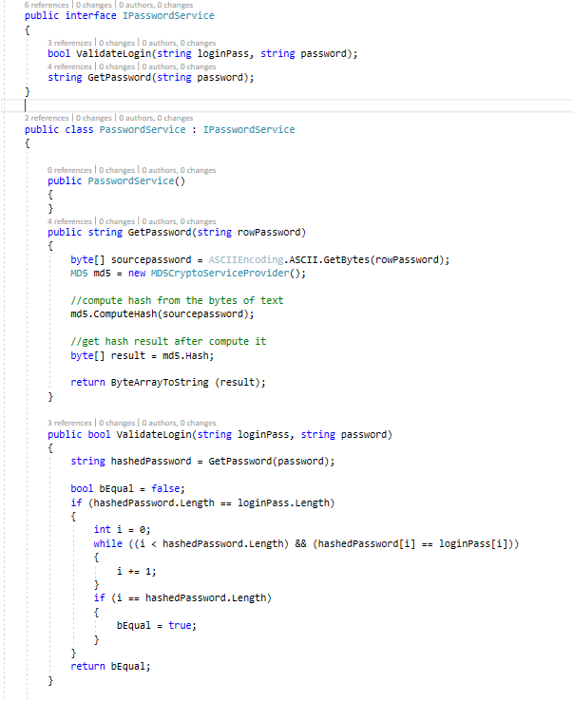
Revisit INTERFACE
Contract between itself and any class that implements it.
It contains only declaration of its members and implementation of its members will be given by the class who implements the interface

Slide 6
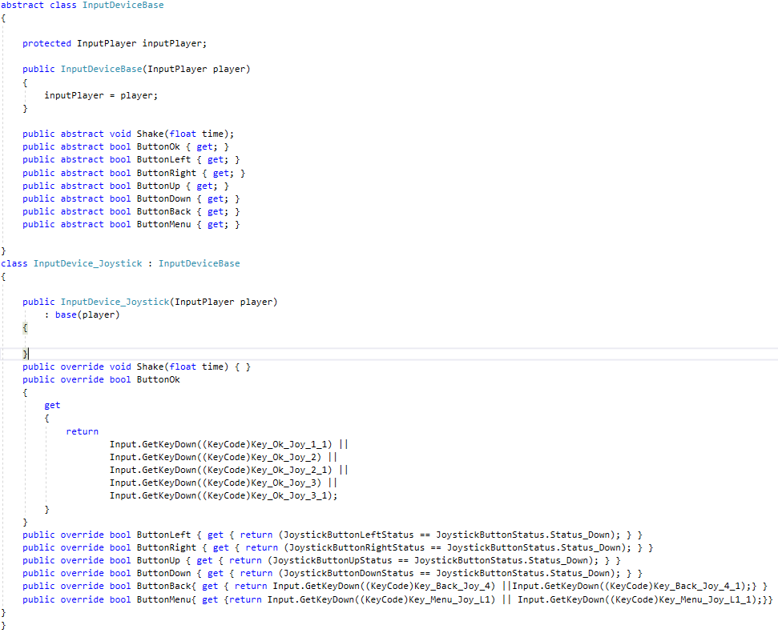
REVISIT Abstraction
An instance of an abstract class can not be created.
A class inherits from the abstract class need to implement all its abstract members.
Abstract class can contains non abstract methods but at least one abstract method.

Slide 7
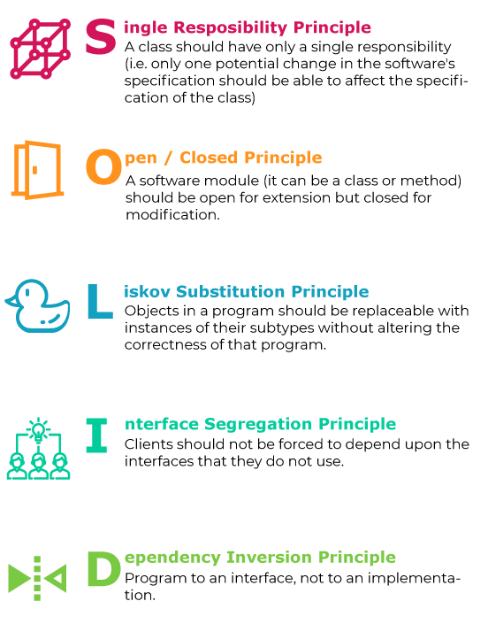
SOLID PRINCIPLE
S – SINGLE RESPONSIBILITY PRINCINPLE
O – OPEN CLOSED PRINCIPLE
L – LISKOV SUBSTITUTION PRINCIPLE
I – INTERFACE SEGREGATION PRINCIPLE
D – DEPENDENCY INVERSION PRINCIPLE

Slide 8
SINGLE RESPONSIBILITY PRINCIPLE
A class (or method) should only have one responsibility hence only one reason to change
Benefits
Easier to understand
Easier to maintain.
Change less frequently.
Easily Testable

Slide 9
DEMO

Slide 10
OPEN /CLOSED PRINCIPLE
A class should be open for extension but closed for modification
Benefits
Not allowing modification limits introducing new bugs
All dependent classes will not need to adapt modification

Slide 11



DEMO

Slide 12
LISKOV SUBSTITUTION PRINCIPLE
It is a principle of OOP and states that derived classes should be able to extend their base classes without changing/affecting their behavior.
It is an extension of the Open Close Principle and is violated when you have written code that throws "not implemented exceptions"
Benefits
No surprising behavior for callers when substitution applies.
Code reusable and loosely coupled.

Slide 13
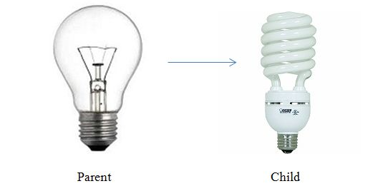
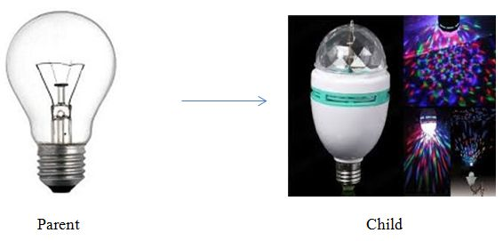
DEMO
Perfect Substitution
Violation Substitution

Slide 14
INTERFACE SEGREGATION PRINCIPLE
Client (class implementation interface) should not force to implement Interface that they don't use.
Do not design a big fat interface that forces the client to implement a method that is not required by it, instead design a small interface
Benefits
Normalizing code.
Easier to manage and test.

Slide 15
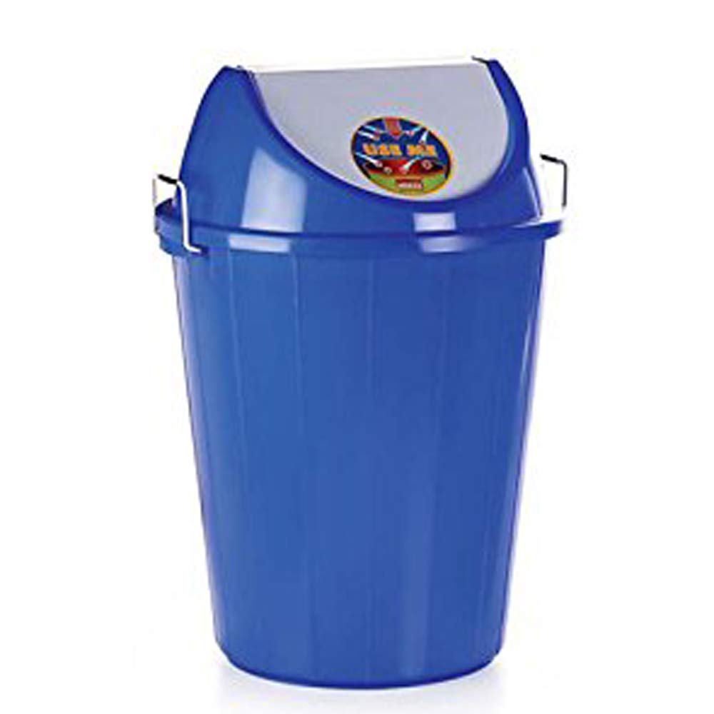
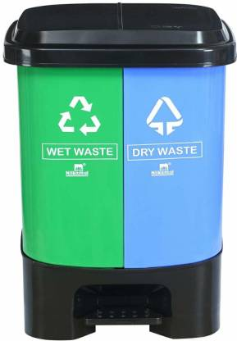
DEMO

Slide 16
DEPENDENCY INVERSION PRINCIPLE
High-level modules should not depend on low level modules and vice versa, both should depend upon abstraction.
No tight coupling should be among components (Viz. modules, classes) of software and to avoid that, they should depend on abstraction.
Benefits
Parallel development of the module becomes easy
Allow mock testing efficiently.

Slide 17
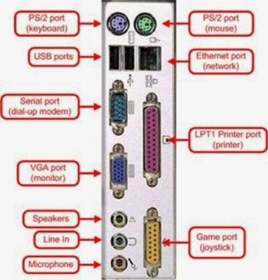

DEMO

Slide 18

Thank YOU

